Slide 1

Recommendation using Collaborative Filtering
By
Chris Alexander
Viveka Salinamakki

Slide 2
What is a Recommendation System?
Predicts/Recommends the products or services that users would buy or consume
Used in e-commerce, entertainment content, social media posts, advertisements, music, etc
Types of recommendation
Collaborative-based Filtering
Content-based Filtering

Slide 3
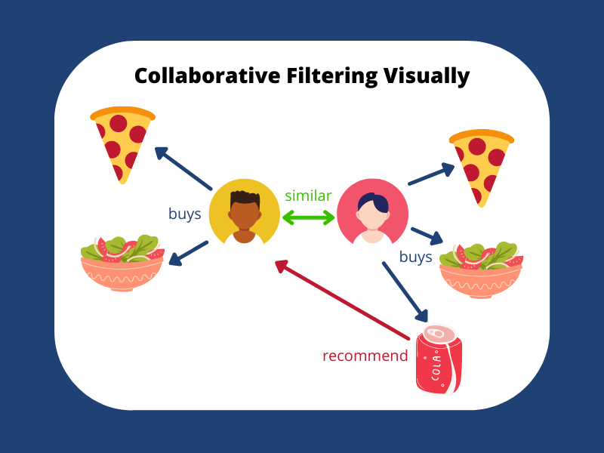
What is Collaborative Filtering?
Finds similar patterns among users
Filters out items that users like based on the ratings or reactions of similar users
Image Credits

Slide 4

Types of Collaborative Filtering
Based on User similarity
Based on item similarity
Find users sharing similar rating patterns with test user
Ratings from these users used to calculate a prediction
Relationships among items found using item-item matrix
Match user’s data with this matrix to get preferences

Slide 5
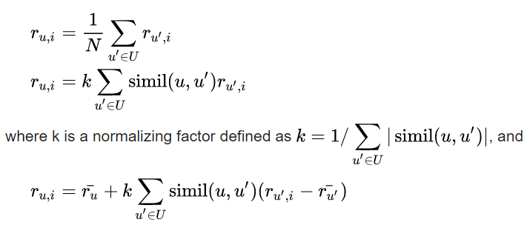
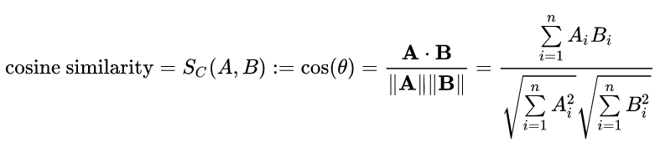
Similarity Check
Similarity can be computed as follows
Source
Source

Slide 6
PyTorch
Based on an open-source machine learning library called Torch
Python frontend combined with Torch's powerful GPU-accelerated backend libraries to create a flexible and efficient system
Framework for building Deep Learning models

Slide 7
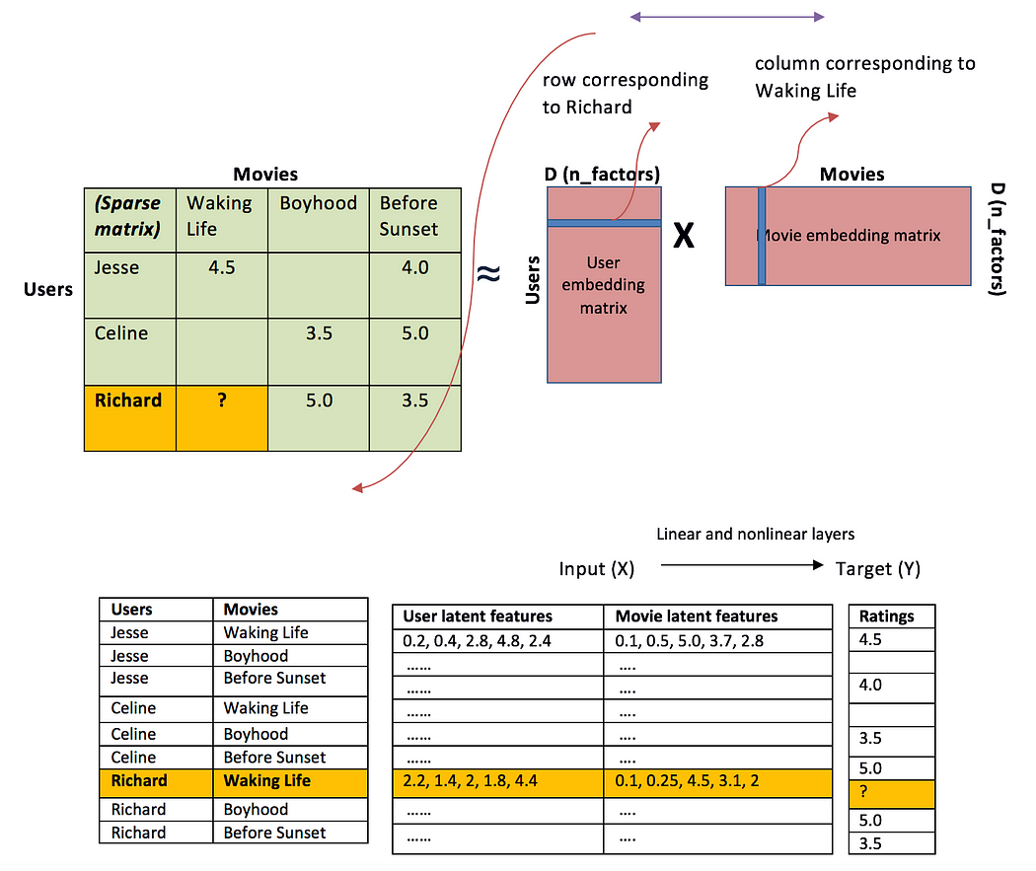
Embeddings
The users and movies are converted into embeddings
The multiplication of these matrices gives a prediction
This prediction is then scaled to the range of the ratings
Image Credits

Slide 8
Dimension Reduction Methods
t-Distributed Stochastic Neighbor Embedding (TSNE)
Principal component analysis-PCA
Uniform Manifold Approximation and Projection, UMAP
Source

Slide 9
PyTorch Deep Neural Network Implementation

Slide 10
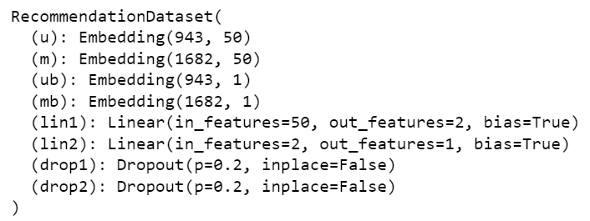
Model Summary

Slide 11
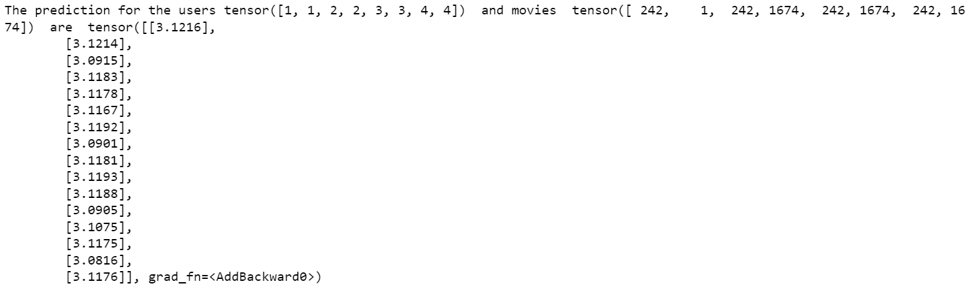
Predictions

Slide 12
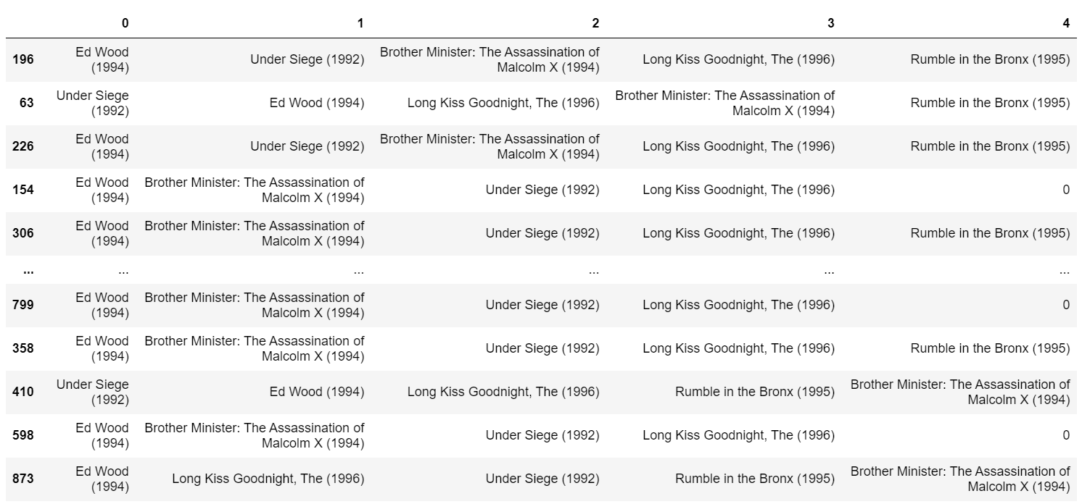
Recommendation

Slide 13
Fastai Implementation

Slide 14
Collaborative filtering using fastai
What is fast ai?
Library built on PyTorch
Elements used to build a collaborative filter from fast ai
Data loader
Learner
loss function(MSE)

Slide 15
Fastai and tools used for the implementation
What is fast AI? Fastai is a comprehensive deep learning library that offers practitioners a range of high-level components to achieve exceptional outcomes in traditional deep learning domains. Additionally, it equips researchers with versatile low-level components that can be flexibly combined and customized to construct novel methodologies.
Dataloaders: DataLoaders extend PyTorch's DataLoader Class by providing enhanced functionality and flexibility. They offer a range of capabilities to assist in exploring, cleaning, modifying, and preparing data throughout the entire process of building a deep learning model. DataLoaders are indispensable when constructing a fastai model, as they facilitate the efficient handling and transformation of data at various stages, ensuring optimal utilization within the model.
Learner: The integration of the model, DataLoader, and loss function within a unified framework enables the generation of weights or embedding vectors for the features, while also learning biases associated with each feature. By combining these components, the system is able to optimize and extract meaningful representations from the input data. The model leverages the DataLoader to efficiently process and transform the data, while the loss function guides the learning process by quantifying the discrepancy between predicted and actual outcomes.
MSE Loss function:The Mean Squared Error (MSE) loss function is defined as the average of the squared differences between the actual and predicted values. It serves as a widely utilized loss function in regression tasks. By computing the squared differences and taking their average, the MSE loss effectively quantifies the overall magnitude of the prediction errors. This makes it a popular choice for regression problems, as it provides a measure of how well the model fits the data and enables the optimization process to minimize the discrepancy between predicted and actual values.

Slide 16
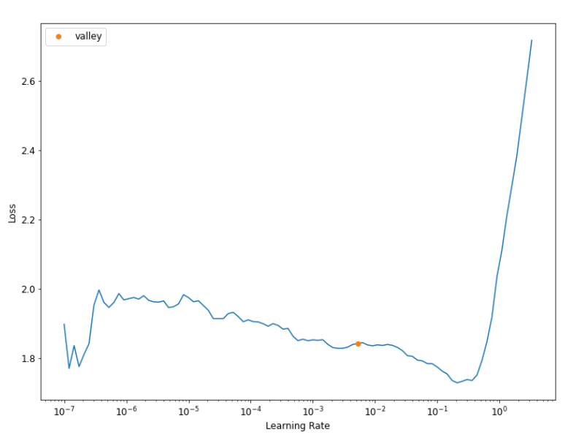
Choosing a Learning rate

Slide 17
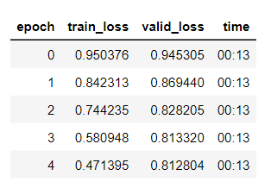
Model training

Slide 18
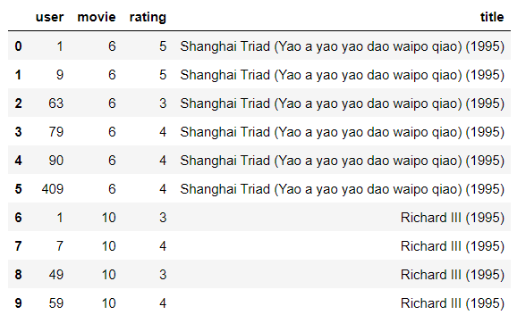
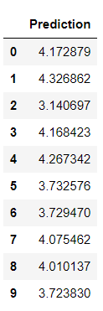
Test predicted and actual value

Slide 19
Dimension Reduction Methods
TSNE (t-distributed Stochastic Neighbor Embedding) is a manifold learning technique that aims to map high-dimensional data onto a lower-dimensional manifold. By doing so, it generates an embedding that preserves the local structure of the data. TSNE is primarily employed for visualization purposes due to its ability to reveal patterns and clusters within the data. Furthermore, TSNE does not support transforming new data points into the embedding space.
A promising alternative to TSNE is UMAP (Uniform Manifold Approximation and Projection). UMAP not only provides visualization capabilities but also supports the transformation of new data into the embedding space. This flexibility makes UMAP a powerful tool for both visualization and subsequent analysis or prediction tasks involving unseen data.
Principal Component Analysis (PCA) is a popular approach used to analyze extensive datasets that have a high number of dimensions or features per observation. The main goal of PCA is to increase data interpretability while preserving as much relevant information as possible. By reducing the dataset's dimensionality, PCA enables the visualization of complex, multidimensional data. It achieves this by identifying the principal components that capture the most significant variations in the data. These components provide a concise summary of the dataset, allowing analysts to gain insights into its underlying patterns and structures.

Slide 20
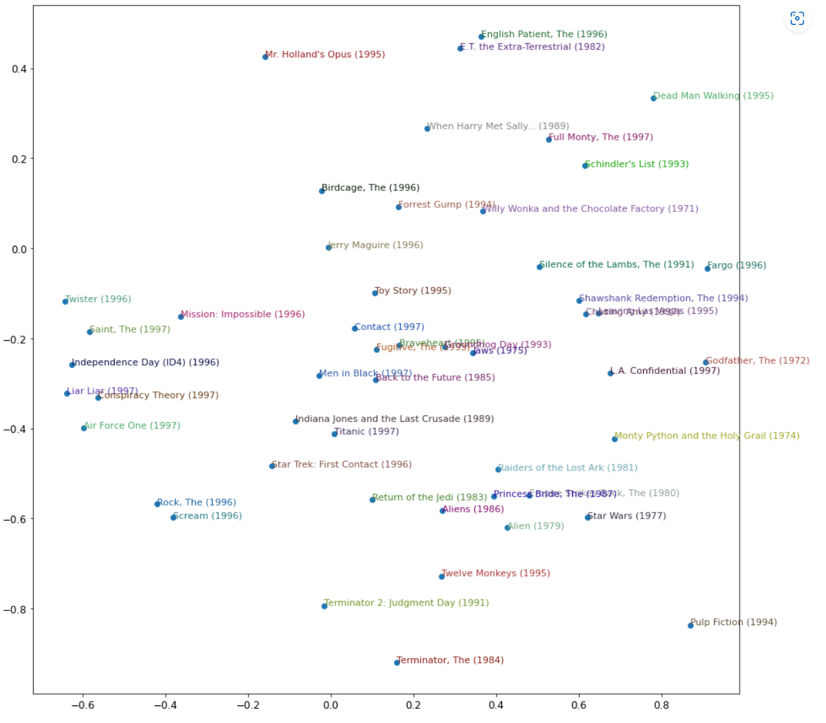
2D Embedding

Slide 21
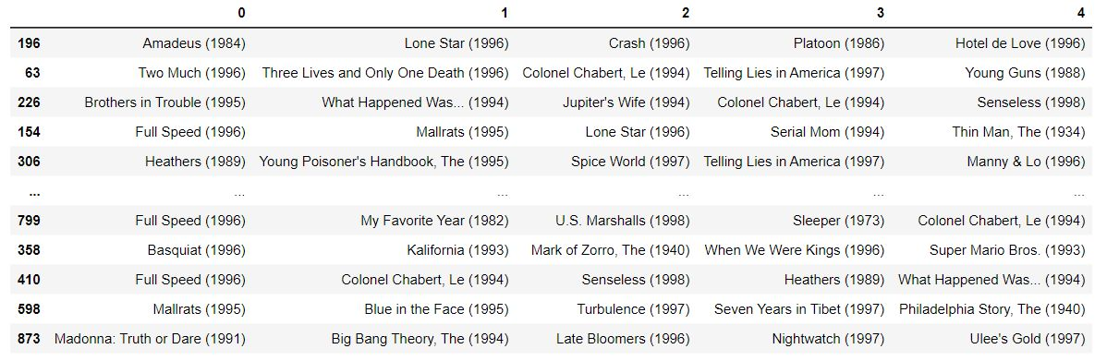
Recommendation

Slide 22
Future scope
Incorporate into real world applications
Test for a larger data set
Use a content-based recommendation for initial recommendation in addition to collaborative filtering

Slide 23
Sources
fastai - Collaborative filtering tutorial
https://pytorch.org/docs/stable/index.html
https://ai.plainenglish.io/fast-ai-recommendations-using-collaborative-filtering-d2dec7c702e9
Interactive Analysis of Sentence Embeddings (amitness.com)
Neural Network Embeddings Explained | by Will Koehrsen | Towards Data Science
F. Maxwell Harper and Joseph A. Konstan. 2015
[The MovieLens Datasets: History and Context. ACM Transactions on Interactive Intelligent Systems (TiiS) 5, 4, Article 19 (December 2015), 19 pages. DOI=http://dx.doi.org/10.1145/2827872]

